Slide 1
Introducing JFC
CS 5100
Lecture 07

Slide 2
Java Foundation Classes and Swing
Set of APIs based on Swing
Swing extends, and coexists with, AWT
  Lightweight components
  PLAF
  Delegation event model
  Localization, accessibility, and beans
  MVC

Slide 3
AWT
The primary Java GUI toolkit
Provides visible components, color, images
Associated with applets, beans
Depends on native peers, conforms to their look-and-feel
Heavyweight
Could provide lightweight components on a Canvas

Slide 4
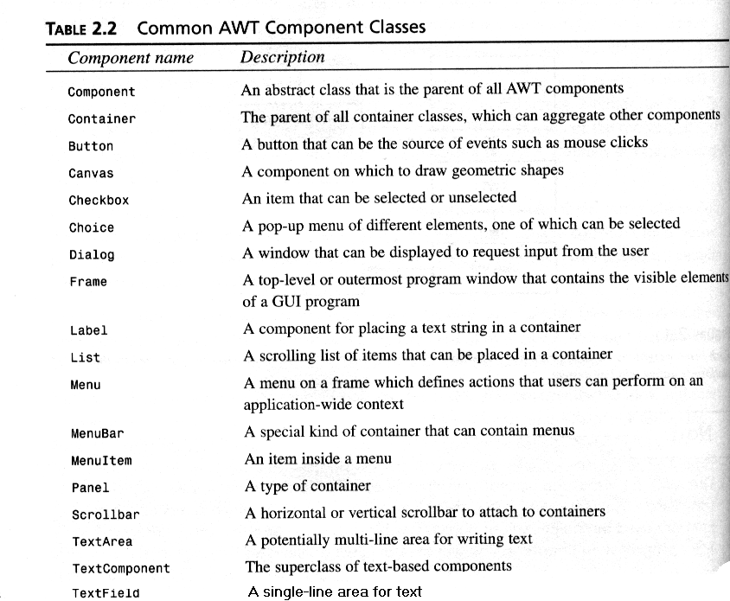
AWT Component List

Slide 5
AWT Components
Derived from Object and provide
  Graphics, foreground and background, font, cursor
  Max, min, and preferred sizes
  Dimension and screen location
  Locale, parent, peer
Containers and layout managers
Component and Container are both abstract
All Swing comps derive from Container

Slide 6
The Delegation Event Model
Events are generated by external asynchronous actions
Events have sources and carry data
Source objects have added (registered) listeners
Adaptors

Slide 7
The JFC Containment Model
Most containers are lightweight, and may contain specialized auxiliary containers:
  root pane manages others
  content pane holds components
  layered pane manages content stacking, overlay
  glass pane does cross-component drawing and intercepts events directed at individual objects
  menubar pane
Remember that the containment and inheritance hierarchies are totally distinct

Slide 8
The MVC Model
Logically, GUI elements have three aspects:
  The model is a non-visual data structure
  The view is a visual display of data
  The controller handles events related to the data
  Synchronization is maintained by messages between the model and view
JFC often collapses view and controller into a single class
JFC provides a number of Abstraction Models with default implementations

